Slide 1
The EAR By Dr.Alaa Hussein Saadoon
The ear is a paired sensory organ, that is involved in both hearing and balance. For this reason, the ear is known as the vestibulocochlear organ.
Anatomically, the ear can be looked at in three parts:
1. External ear – pinna(الصيوان ) and external acoustic meatus down to the level of the tympanic membrane
2. Middle ear - contains the malleus, incus and stapes (المطرقة، السندان والركابي ) bones - known as the ossicles
3. Inner ear - contains the membranous and bony labyrinths, and the cochlea .( المتاهات العظمية والغشائية ، والقوقعة).

Slide 2
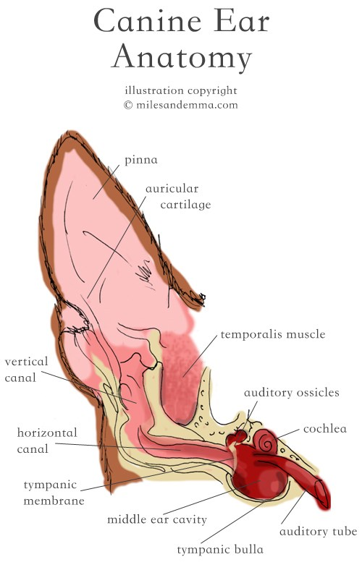

Slide 3
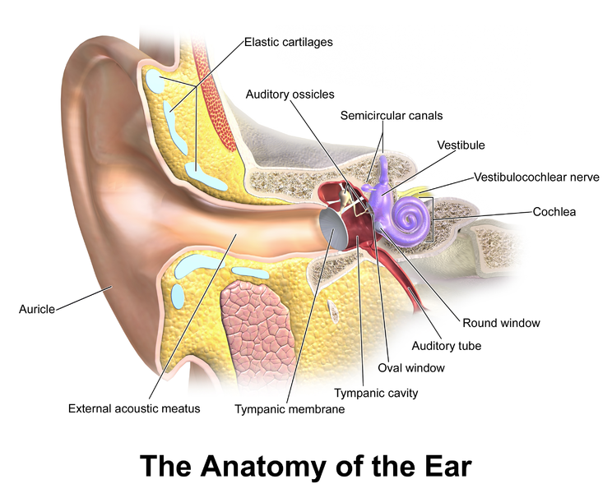

Slide 4
1- The External Ear : consist of two parts , the auricle or pinna and the external acoustic meatus . The pinna consists of the auricular cartilage, and skin which allows for flexibility and elasticity. The auricle shape like a funnel distally it is wide open to receive the sound and more proximally it is rolled up to form a tube known as the concha , that bends medially to connection with the external acoustic meatus . The scutiform cartilage lies rostromedially in the lower ear canal and provides support.
The auricle can be turned toward the source of sound; right and left so that each can focus on separate sounds.

Slide 5
A complex set of voluntary auricular muscles, that arises from different points in the skill can responsible for the movement of the ear. The auricular muscles are innervated by branches of the facial nerve.
The external acoustic meatus being where the concha narrow and ends at the eardrum (طبلة الأذن) .
The meatus therefore has cartilaginous and osseous parts. It is lined with skin that contains sebaceous and tubular ceruminous gland, that secrete the earwax (cerumen), which prevent dust from reaching the delicate tympanic membrane.
The ear of the dog is of the most clinical interest , its external acoustic meatus is curved.

Slide 6
The middle ear
The middle ear consists of the tympanic cavity, the auditory ossicles and the eustachian tube. The boundary between the middle and inner ear is the oval window. The auditory ossicles are attached to the wall of the tympanic cavity by many ligaments and mucosal folds. The tympanic cavity is located within the temporal bone, and can be divided into dorsal, middle and ventral parts:
Dorsal: conatining 2 of the auditory ossicles – the malleus and incus

Slide 7
Middle: bounded by the tympanic membrane laterally and containing the third auditory ossicle, stapes, attached to the oval window. It opens rostrally into the nasopharynx via the eustachian tube
Ventral: or fundic cavity, which is the largest compartment. It is housed by the tympanic bulla which is a thin-walled, bulbous expansion of the temporal bone. The bulla varies in prominence among species ; in some it is subdivided into numerous bony cells .

Slide 8
Sound vibrations are transmitted from the tympanic membrane, across the tympanic cavity, via the ossicles (malleus, incus, then stapes). The ossicles, as well as transmitting sound vibrations from the tympanic membrane, also magnify the vibrations by about 20 times. The magnification is achieved by the action of two muscles that are attached to the ossicles, the tensor tympani muscle and the stapedius muscle(العضلة الموترة للطبلة والعضلات الركابي).

Slide 9
The ratio of the malleus : incus in dogs and cats is 2-3 times that of man, and may explain the increased acuity of hearing.. Associated structures in the wall of the tympanic cavity (bulla) are the facial nerve, vagus nerve and branches of the carotid and lingual arteries. Post-ganglionic fibres of the cervical sympathetic trunk run in the region of the dorsomedial wall of the tympanic cavity.
The feline middle ear has an incomplete bony septum dividing the ventral chamber into a large ventromedial and small dorsolateral chamber, communicating caudomedially.

Slide 10
The tympanic membrane or eardrum : Is a thin partition separating the lumen of the external acoustic meatus from that of the tympanic cavity .It is slanted (مائل )and its surface is larger than transected external acoustic meatus . The lateral surface is covered with an epidermis continuous with that of the meatus , its medial surface covered with the mucosa lining the tympanic cavity . A layer of fibrous tissue between the two layer firmly attached the membrane to the osseous tympanic ring of the temporal bone .

Slide 11
The eustachian tube: Is a tube connects the tympanic cavity to the nasopharynx. Its function to equalize pressure on either side of the tympanic cavity, by opening while yawning(التثاوب ) or swallowing(البلع ), for example .

Slide 12
INNER EAR
The inner ear is located within the petrous temporal bone and contains the membranous labyrinth(المتاهات الغشائية ), which is surrounded by the bony labyrinth(المتاهات العظمية ). The membranous labyrinth is an interconnected group of fluid-filled membranous sacs. The fluid is endolymph. The movement of the endolymph , stimulates the sensory cells within the membranous wall.

Slide 13
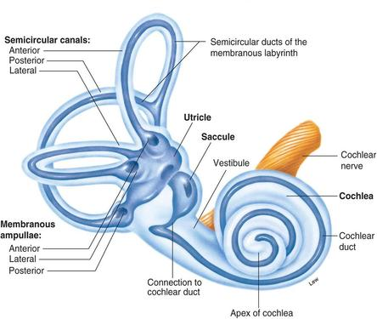

Slide 14
The membranous labyrinth consists of:
1- Vestibular labyrinth: contains the receptor organ involved with balance, containing the saccule, utricle and the semicircular ducts , that conduct impulses concerned with balance via the vestibular nerve.
- Cochlear labyrinth: contains the organ involved with hearing. It consists of the organ of Corti , within the cochlear duct. The cochlear duct is fluid-filled, the fluid being endolymph. The organ of Corti contains the receptor cells for hearing.
- Ductus reunions(ملتقى القنوات ): this is the duct through which the above two labyrinths communicate

